Slide 1
Python Virtual Workshop
Mahesh Acharya
BscCSIT

Slide 2
We Discussed About
Python in Terminal
Introduction
Core python example
Module in pthon
Simple Project with socket

Slide 3
Python in Terminal
Type =>print(“Python virtual work shop”)
save file as .py extension
Open terminal and goto current directory
Run file (pyhton file_name)

Slide 4
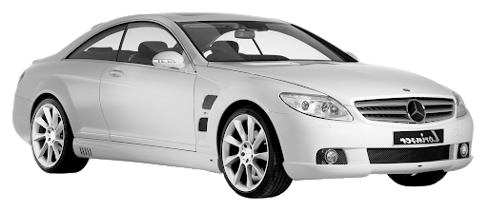
Introduction
Python is object programming language but nut pure object oriented.
Attribute:
name:
model:
methods
geer_system
indicator

Slide 5
But not pure !
class class_name(): def def_name():
__init__(self): .......
......

Slide 6
Synatx
print(“hello world!”)
Indentation
if x<5:
print(“x is less than 5”)

Slide 7
Applications
Web Development
Desktop App
Data Science
AI(Machine Learning, Neural Network, Deep Learning)
Network Programming

